Slide 1
Apache Kafka
KAFKA REAL WORLD

Slide 2
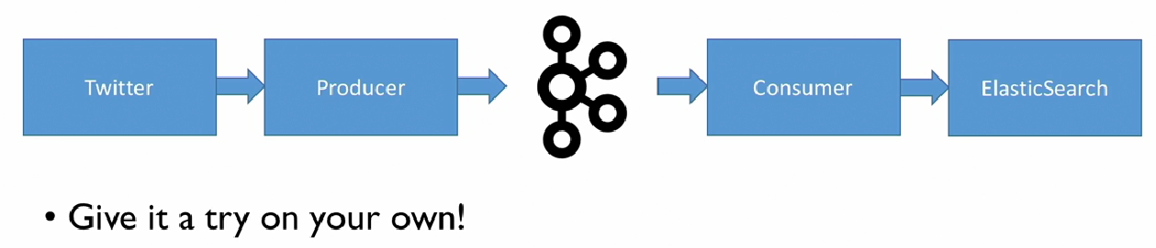
GOAL

Slide 3
Part 1
Twitter API Account.
Hosebird Client is a Java (Maven) twitter client.
You can get the POM dependency from here and plug it into your dependencies in POM.XML.
Write the twitter client
Write the producer
Create the topic
Produce tweets to topic
Make our producer high throughput

Slide 4
Advanced Kafka Concepts

Slide 5
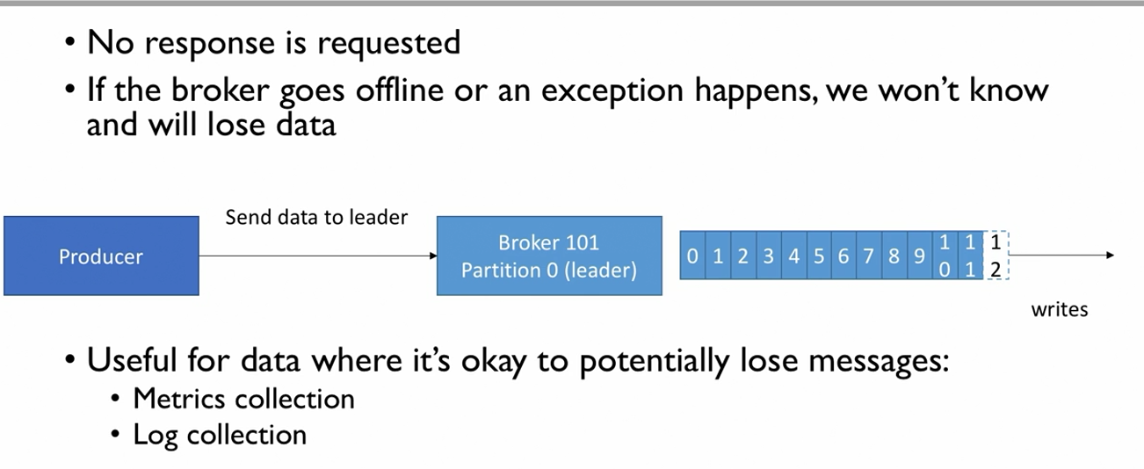
ACKS 0

Slide 6
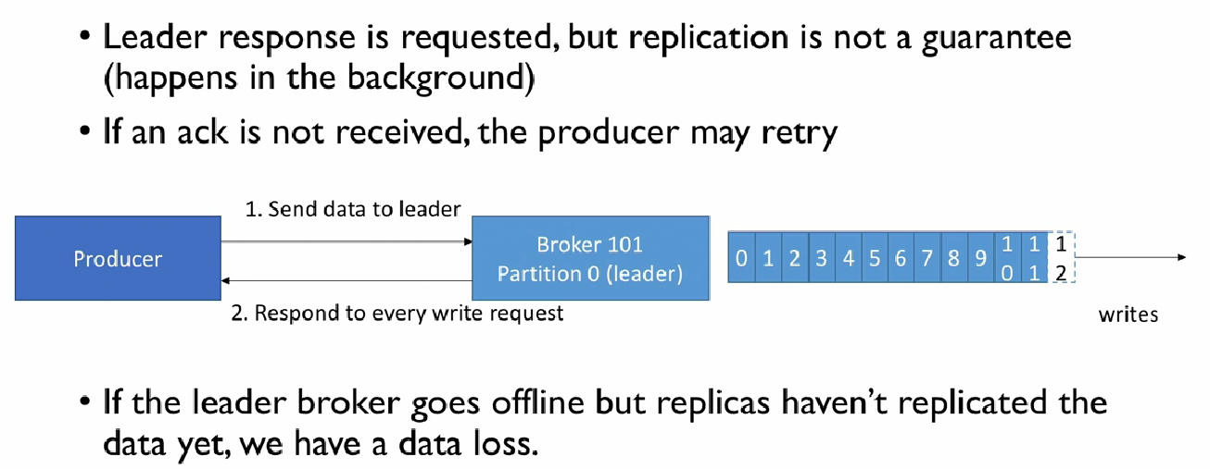
ACKS=1

Slide 7
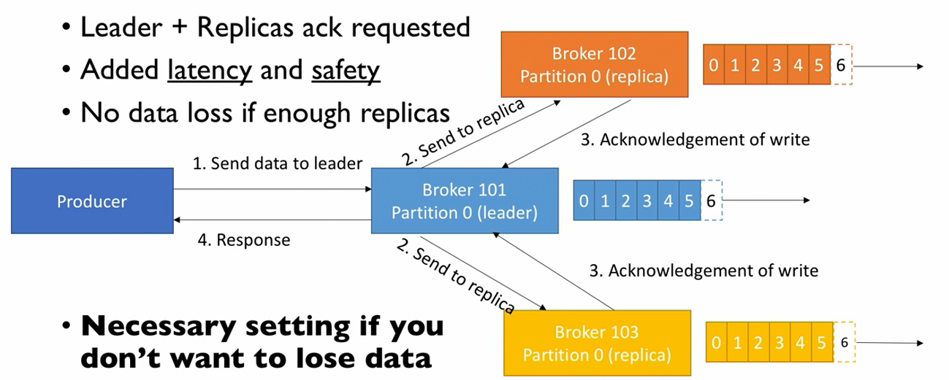
ACKS=all

Slide 8
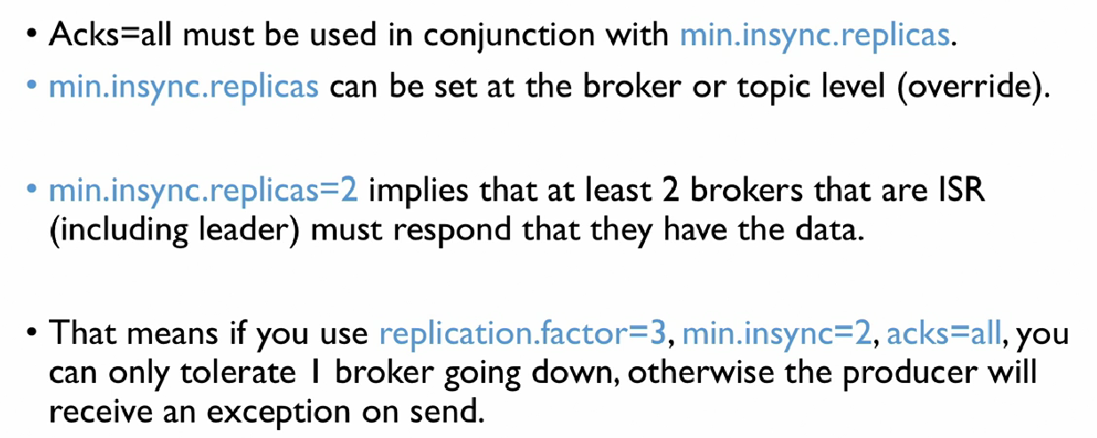
Min.insync.replicas

Slide 9
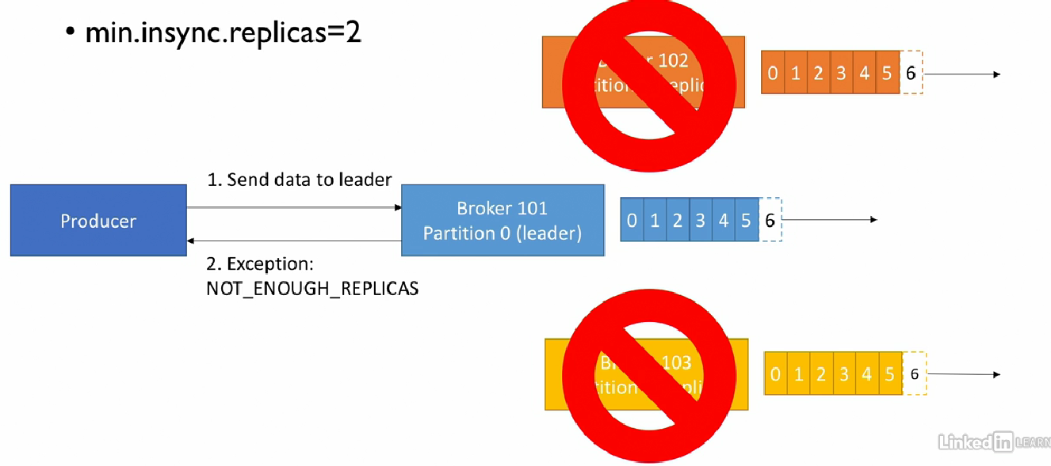
Producer Retry Scenarios

Slide 10
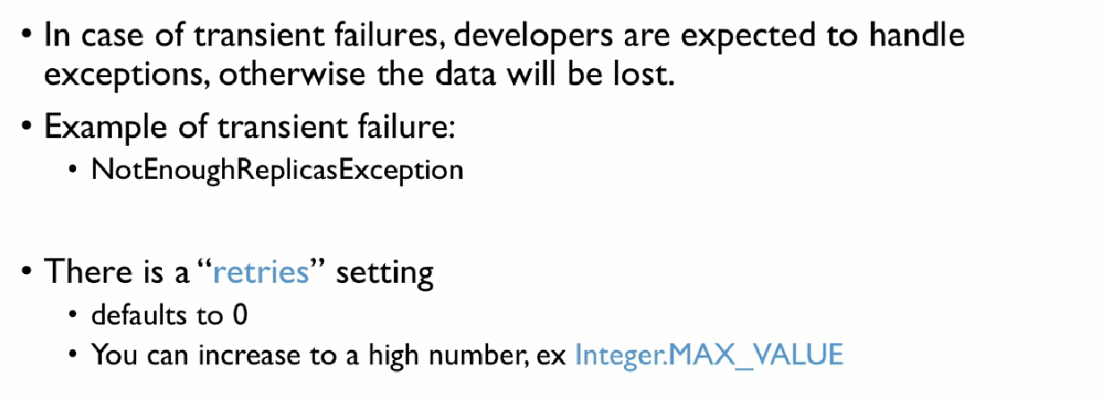
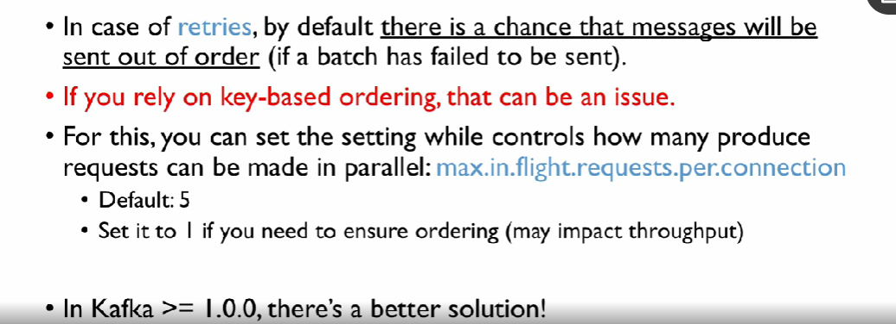
Retries

Slide 11
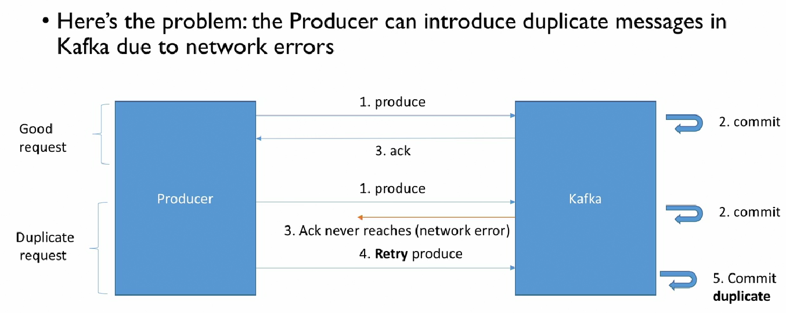
Idempotent Producer

Slide 12
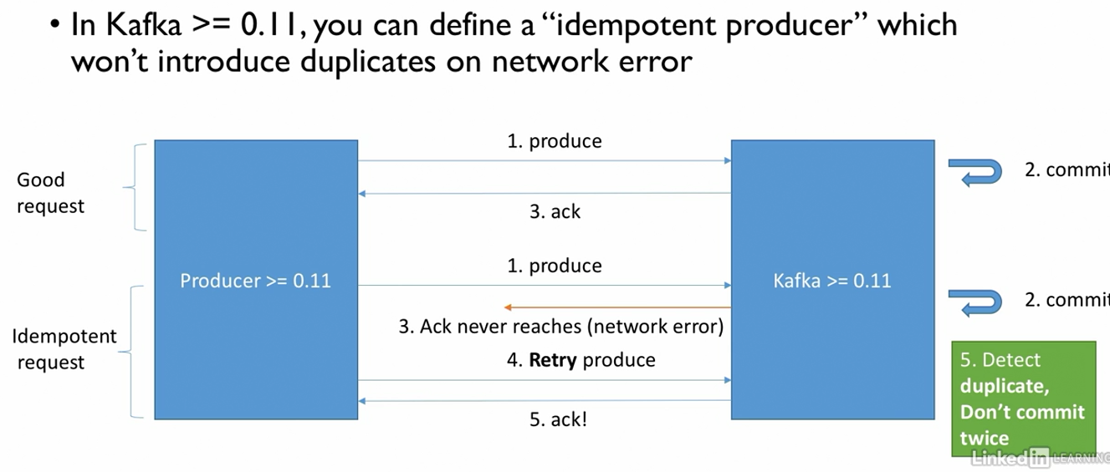
Idempotent Producer

Slide 13
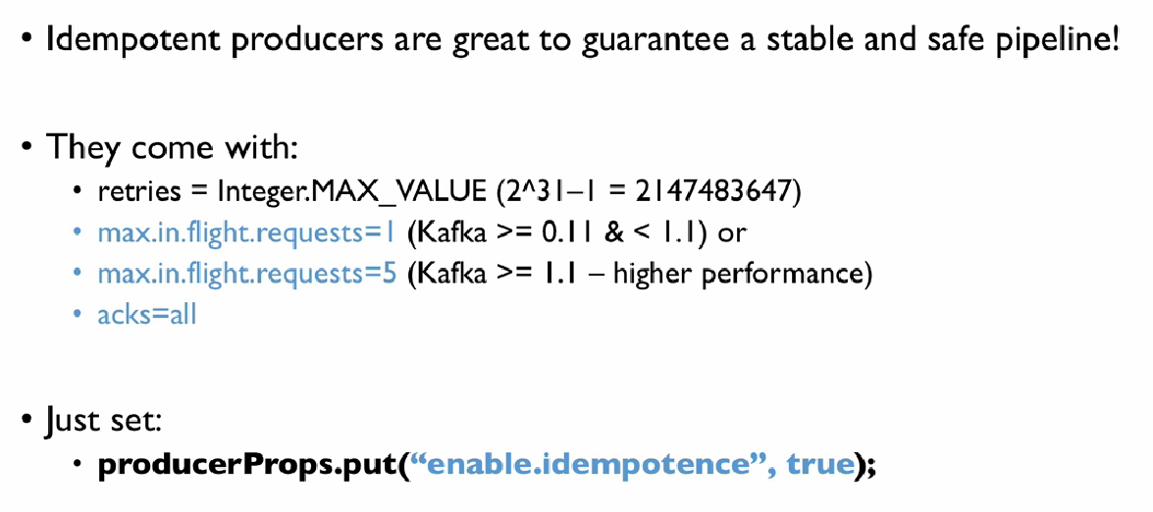
Idempotent Producer (Performance with Guarantee)

Slide 14
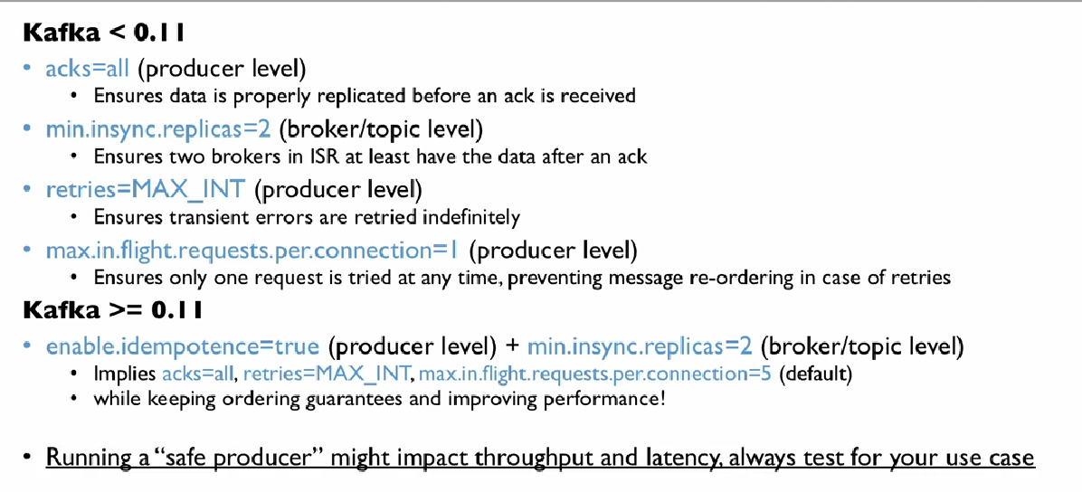
Safe Producer with Performance

Slide 15
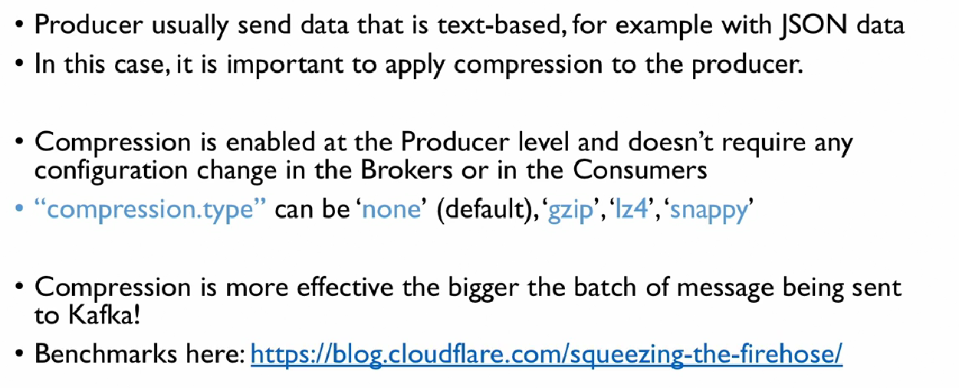
Message Compression

Slide 16
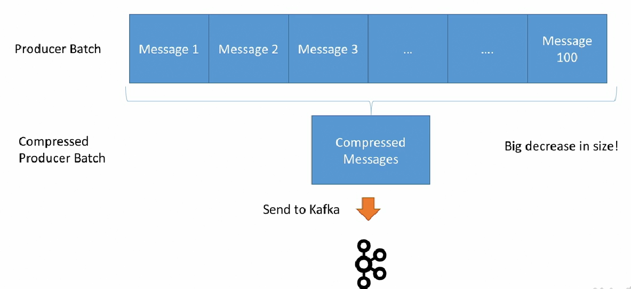
Compression

Slide 17
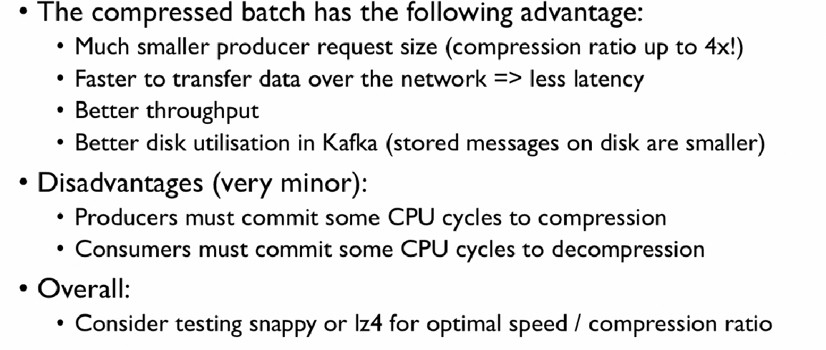
Compression

Slide 18
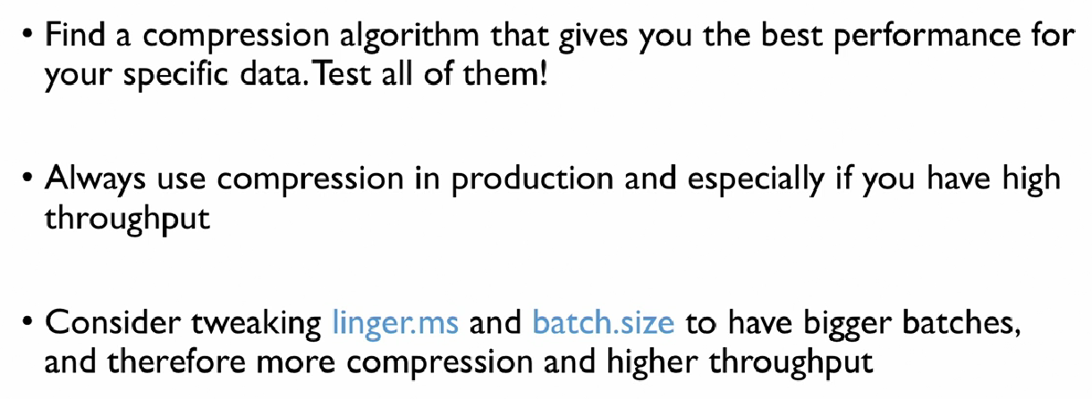
Best Practices

Slide 19
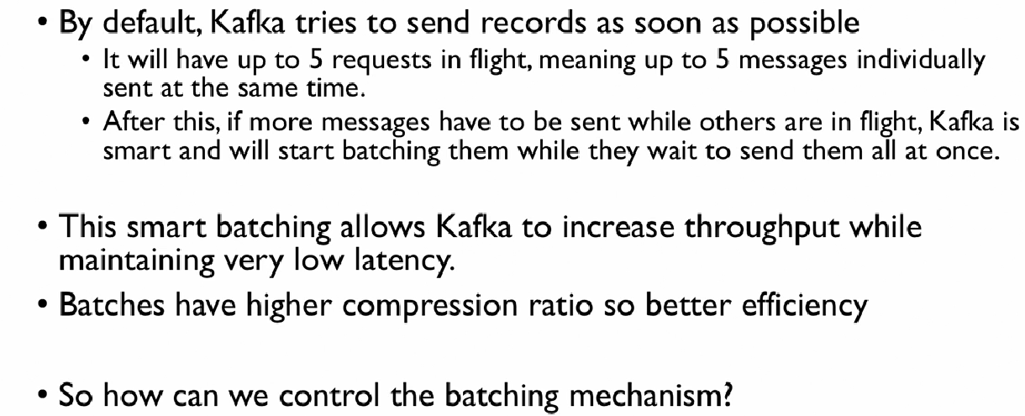
Batching in Kafka

Slide 20
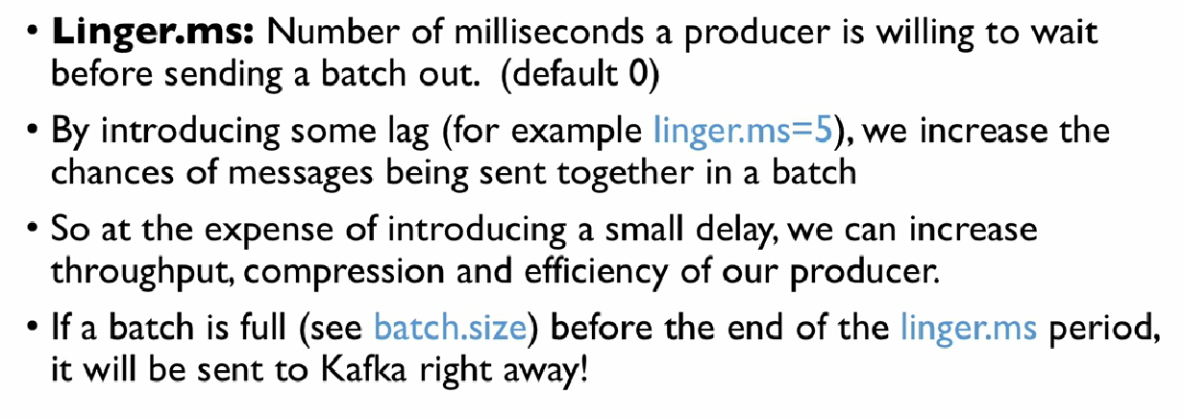
Controlling Batching

Slide 21
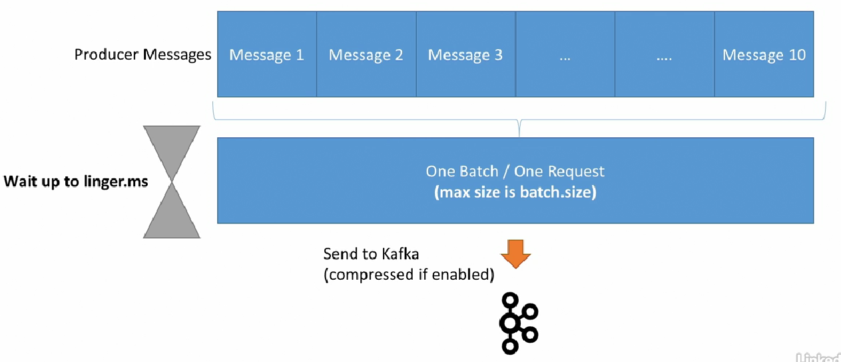
Illustration

Slide 22
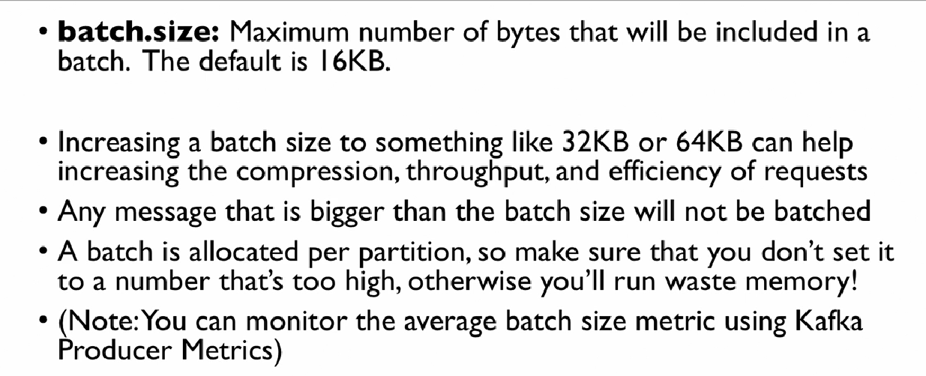
Tuning your Batch Size

Slide 23
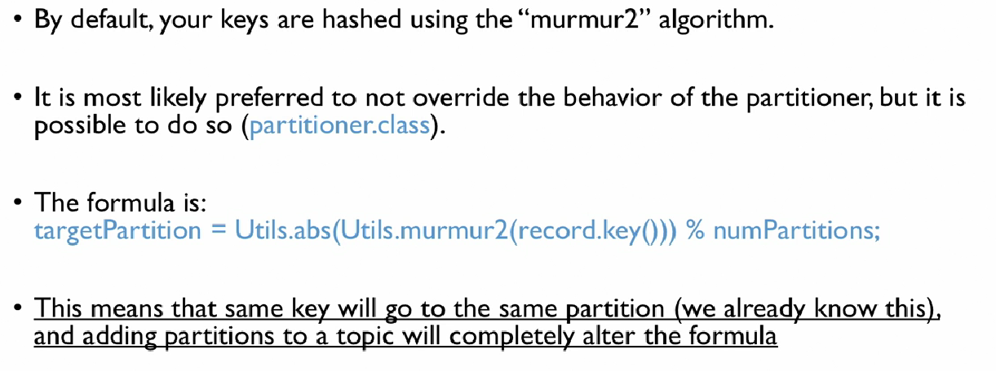
Producer Default Partitioner & Key Hashes

Slide 24

Max.block.ms and buffer.memory
If producer produces faster than the broker can handle, the records will be buffered in the producer
buffer.memory=32 MB - size of send buffer
That buffer will full up over time and fill back down when the throughput to the broker increases
If buffer is full (all 32 Mb) then the send() will start to block
max.block.ms=60000 (60 sec default): the time the .send() will block until throwing an exception. Exceptions are thrown when:
The producer has fulled up its buffer
Broker is not accepting any new data
60 seconds has elapsed
This exception suggests your borkers are down or overloaded and cant respond to requests

